Slide 1
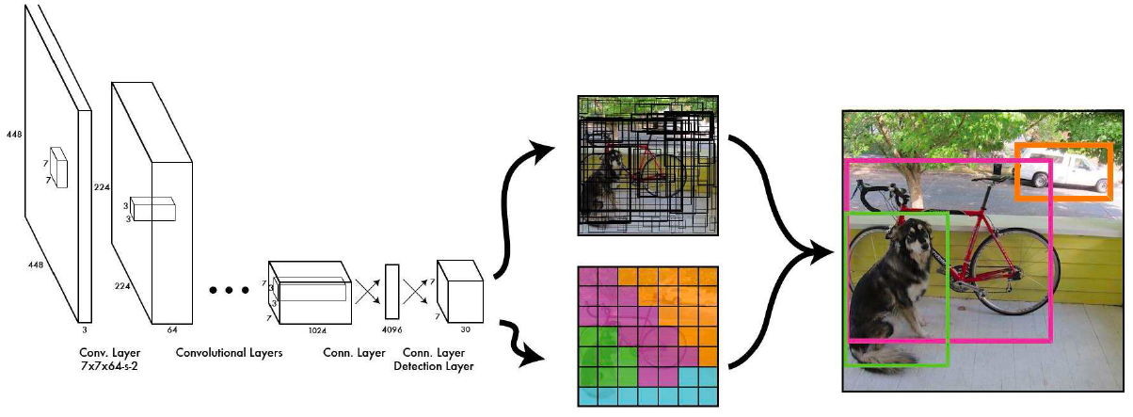
You only look once (YOLO)
Notes:
Source: https://www.youtube.com/watch?v=ZVR2Way4nwQ

Slide 2
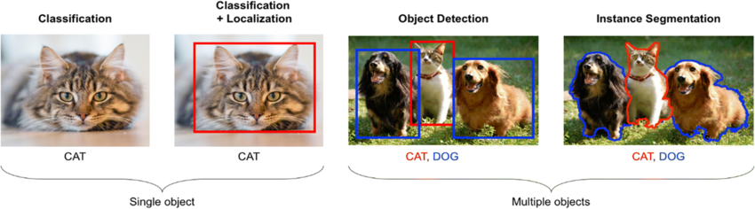

Slide 3
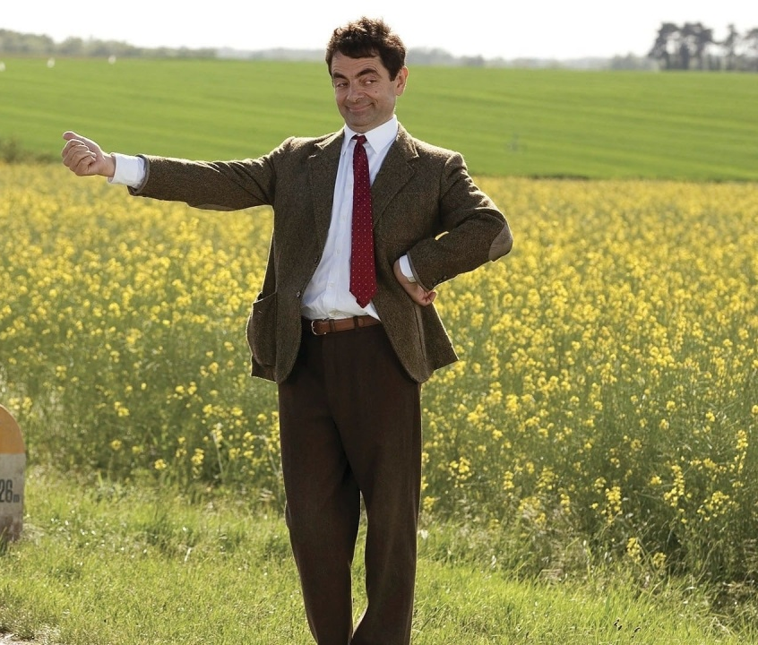
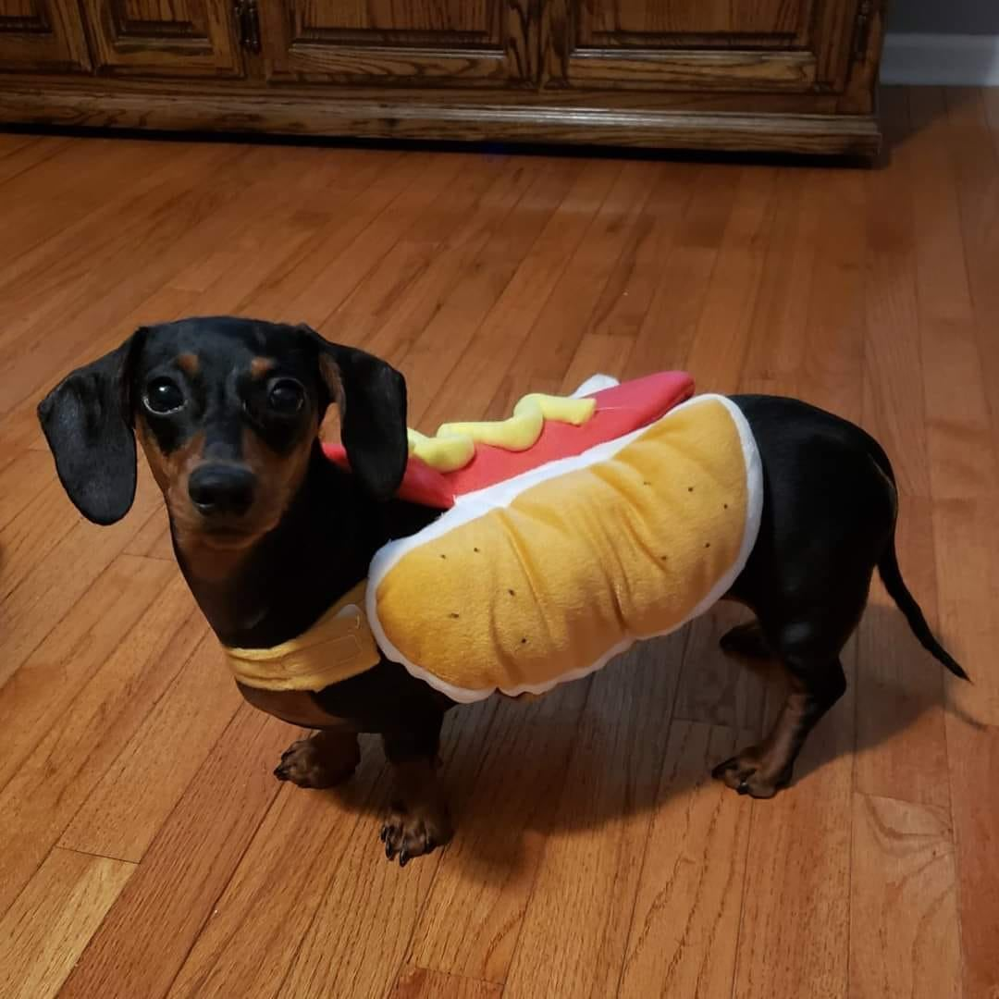

(0,0)
1
80
120
180
220
0
1
P_{c}
B_{x}
B_{y}
B_{w}
B_{h}
C₁
C₂
1
320
300
350
620
1
0
0
-
-
-
-
-
-
(640,640)
C₁ – Dog class
C₂ – Person class
Notes:
The task is to detect if it is a dog or not in the image by using only one bounding box.
Pc is the probability of a class if it is a dog or person then 1 else 0
Bx an By are the coordinates of the center of the bouding box so the yellow stip
Bw and Bh are the width and height of the bounding box
Then for a person
Then for a image without a landscape

Slide 4

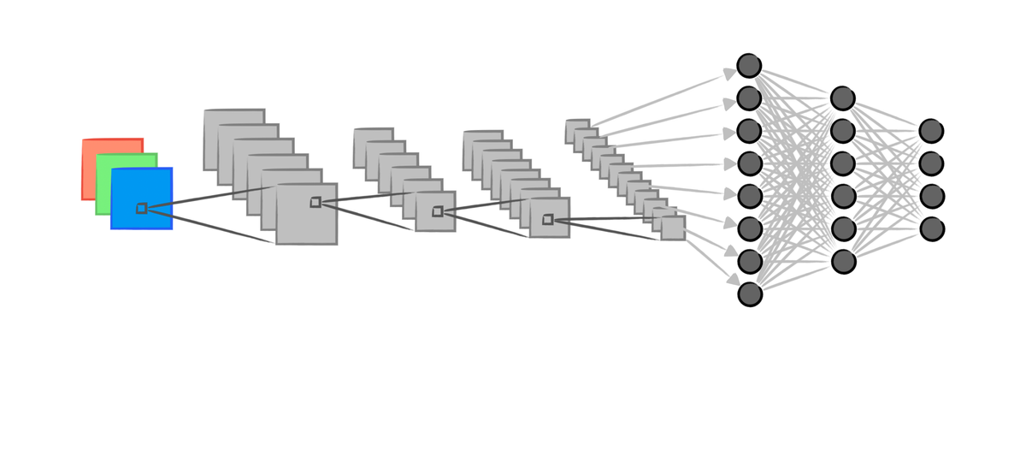



X_train
y_train
Training
Convolutional Neural Network
Notes:
You need to define the bounding boxes since this is a supervised learning algorithm, now you can train the algorithm on thousands images if you want.

Slide 5
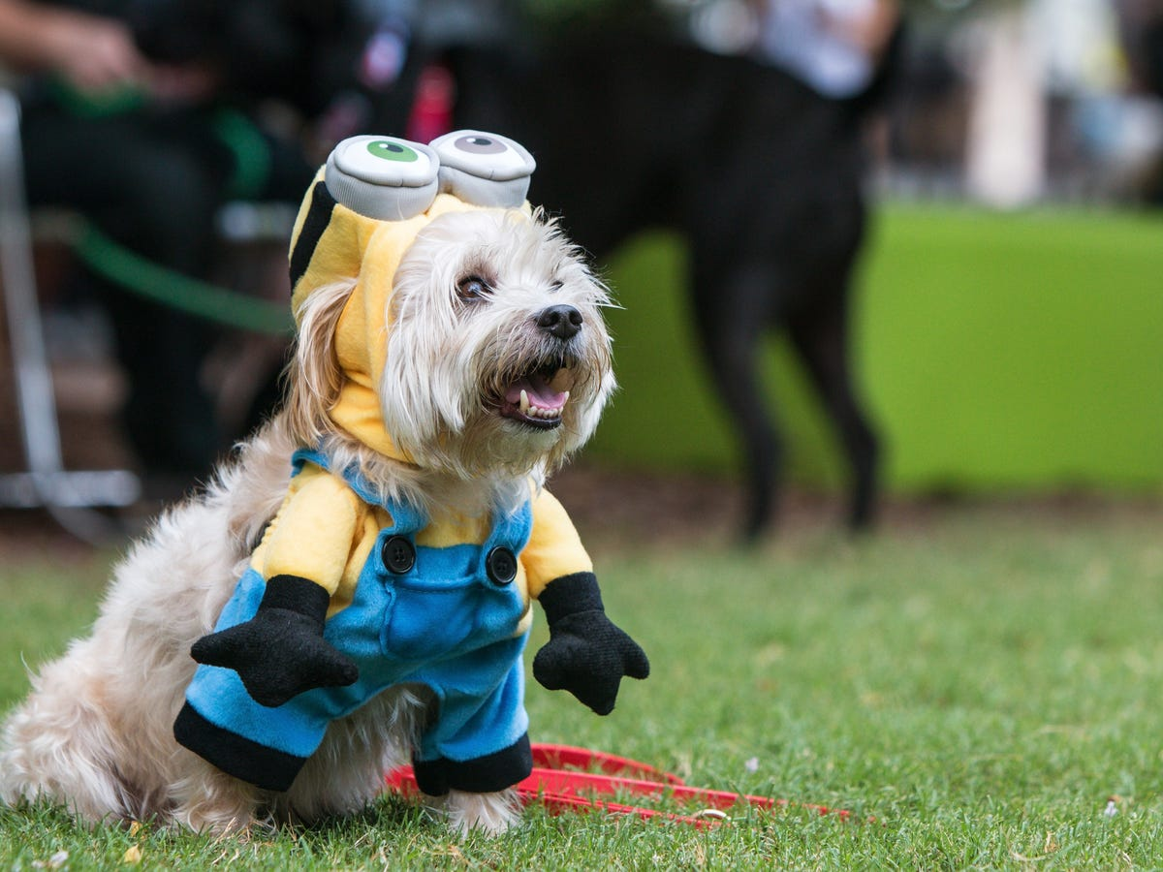
Predicting
1
100
200
250
320
1
0
Convolutional Neural Network
What about multiple objects in the image?
Notes:
The issue; this only works if you want to localize one object in the image but what about multiple objects in the image?
It is hard to predefine the number of objects image because you don’t know, determining the size of the output of your neural network is hard.

Slide 6
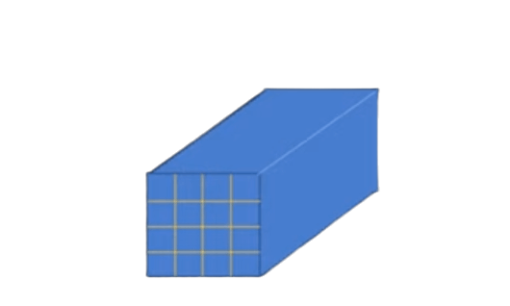
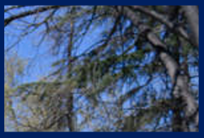
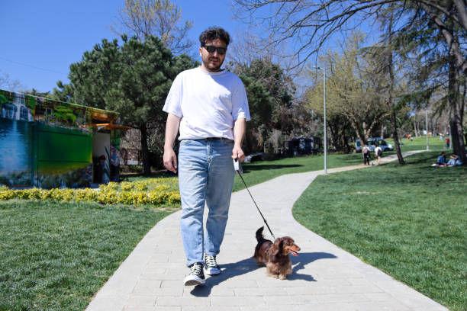
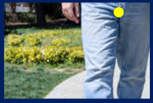
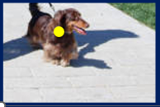
P_{c}
B_{x}
B_{y}
B_{w}
B_{h}
C₁
C₂
0
-
-
-
-
-
-
1
0.8
0.9
2.1
0.8
0
1
(0,0)
1
0.3
0.7
0.5
0.5
1
0
(1,1)
S x S
Notes:
Solotion: Yolo will split the image up into this kind of grid cells, we use a 4x4 grid but could be also 3x3 or 7x7, there is no fixed rule
For each gridcell you can encode the vector we have seen before
For the person the bounding rectangle goes out the gridcell thats okay, thats why Bw en Bh are more then one

Slide 7
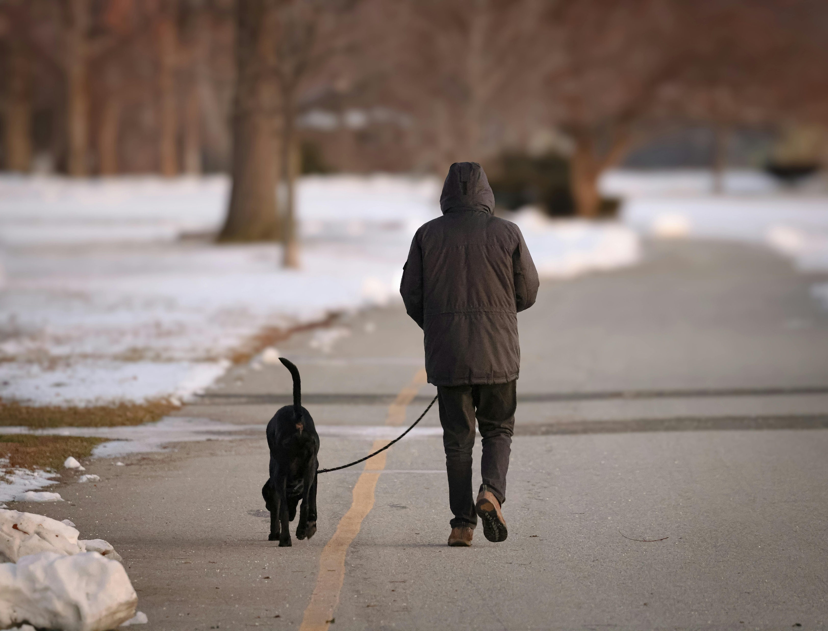
X_train
y_train
16 such
vectors
Training
Convolutional Neural Network
16 such
vectors
16 such
vectors
16 such
vectors
Notes:
You need to define the bounding boxes since this is a supervised learning algorithm, now you can train the algoritm on thousands images if you want.
It is 16 vectors because you have 4 x 4 grid.
YOLO is called You Only Look Once because we are not repeating so we dont do the iteration 16 times. In one forward pass you can do the prediction.
source: https://www.youtube.com/watch?v=ag3DLKsl2vk&t=296s

Slide 8
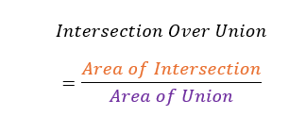
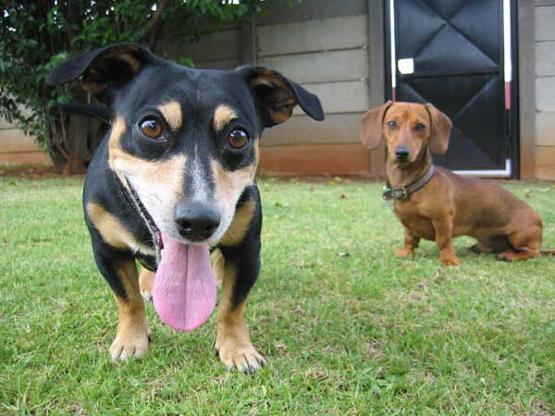
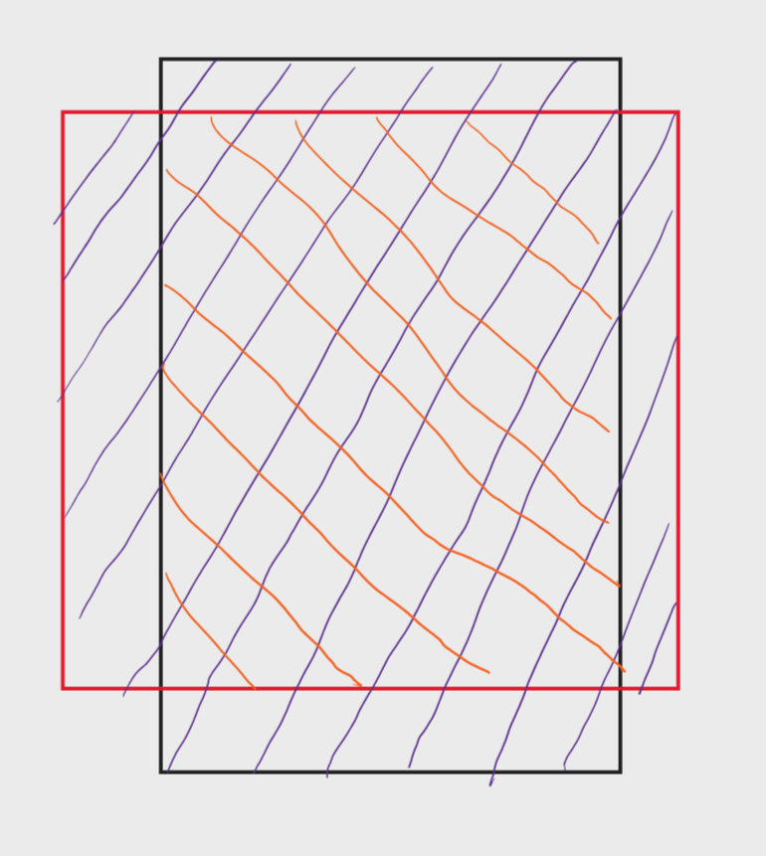
Non Max Supression
0.9
0.7
Box# | Score
1 | 0.5
2 | 0.7
3 | 0.9
4 | 0.8
5 | 0.6
Box# | Score
1 | 0.5
2 | 0.7
4 | 0.8
5 | 0.6
IoU
1
0.8
0.05
0
IoU
1
0.8
0
0
0.5
0.8
0.6
Boxes
3
Notes:
The algorithm detects multiple bouding boxes , the issue is that we only have two objects here.
So what you normally would expect to do is to choose for the highest confidence. However an computer of algorithm doesnt know that there are only two objects here so that doesnt work. So we use the concept IOU Intersection of Union

Slide 9
Non Max Supression
0.9
0.7
Box# | Score
4 | 0.8
5 | 0.6
Box# | Score
5 | 0.6
IoU
1
IoU
1
0.5
0.8
0.6
Boxes
3
4
Notes:
The algorithm detects multiple bouding boxes , the issue is that we only have two objects here.
So what you normally would expect to do is to choose for the highest confidence. However an computer of algorithm doesnt know that there are only two objects here so that doesnt work. So we use the concept IOU Intersection of Union What also could be possible is that one grid cell has center of two objects. In that case you get a vector of size 14 instead of 7. One for the dog for example and one for a person.
Source: https://www.youtube.com/watch?v=v6lt0cGSHBI

